Slide 1
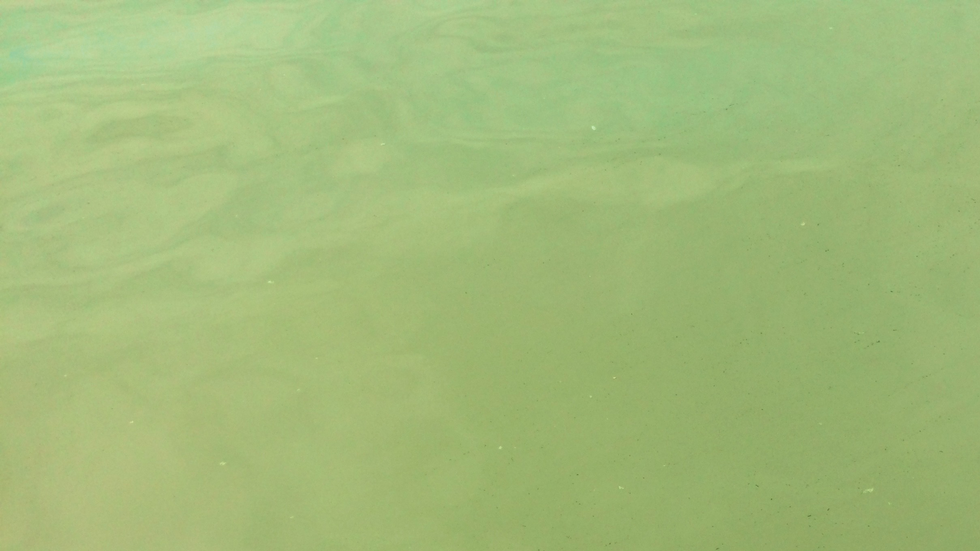
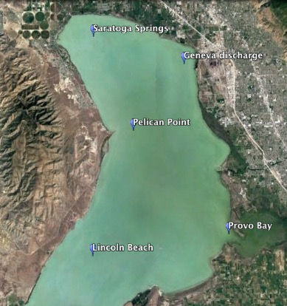

Utah Lake Eutrophication: Water quality and cyanobacterial speciation
Anwar Alsanea. Ramesh Goel. Hanyan Li. Michael Barber. University of Utah
In summer 2016 (May, June, July, August) 5 sites around Utah Lake were sampled with the help of Utah DWQ
Parameters measured:
Physical: pH, temperature.
Chemical: Nutrients (Nitrate-N, Nitrite-N, Phosphate – P) , Chlorophyll a , and Sediment Phosphorus speciation.
Biological: Cyanobacterial Speciation
Samples collected:
Water samples each month at all 5 sites
Sediment samples collected in August after the bloom for all 5 sites

Slide 2
Nutrients: Avg of triplicate measurements via IC
Nitrite-N measurements (July) for Provo Bay were 0.5 mg/L, 0.05 mg/L for Geneva Discharge, and 0.13 mg/L for Saratoga Springs.

Slide 3
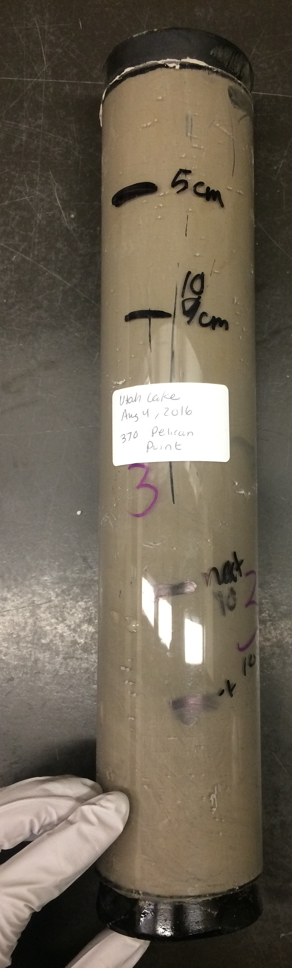
Sediment P-Speciation (August):
based on an avg of triplicate measurements
Loose bound – P : released with slight agitation
8.79 11.41 14.65
22.95 18.09 21.81
13.6 11.86 7.76
12.15 10.24 12.79
Notes:
Spread 1 kg of sediment, in surface area
125 mg/L divided by area – to find flux
COVERT To pore water in the top 5 cm
Covert that pore water to water concentration, plan this summer
Mention
Remove, the nutrients and place all P speciation
0-5 cm
5-10
SHOW exactly how much loosley bound
Per kg of sediment
How much pore water will be in kg
LAB notes, multiply weight by density of water, to get volume of water
Find 25 mg of water in wet sediment, how much mL
125 mg/L of phosphorus
If that P is released
Looe=se bound with agitation,
Specify top 5 cm, with agitation P might be released more in 5 cm
Avg depth

Slide 4
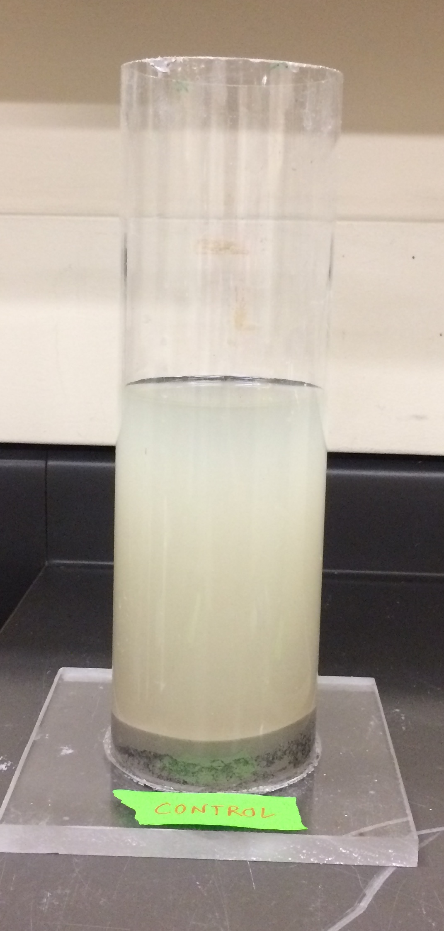
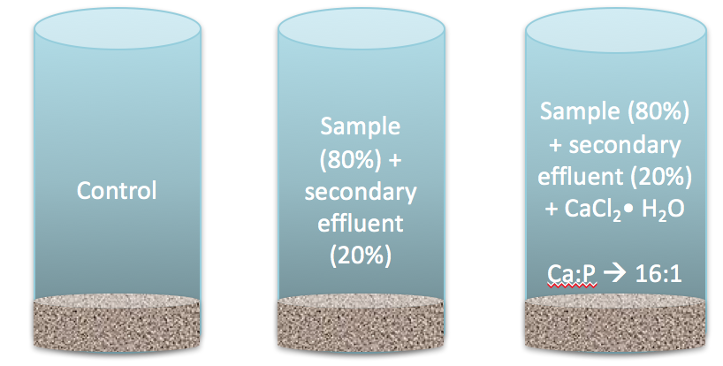
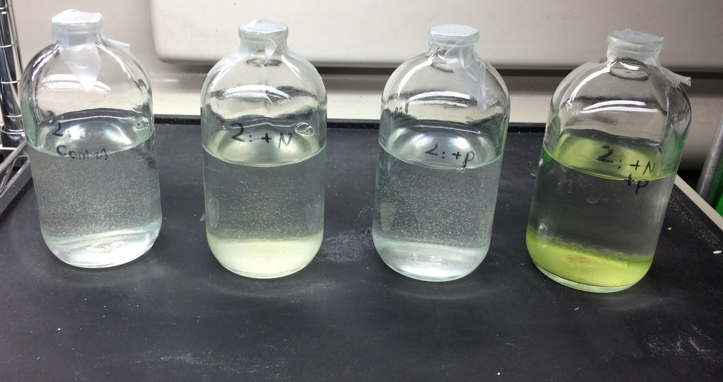
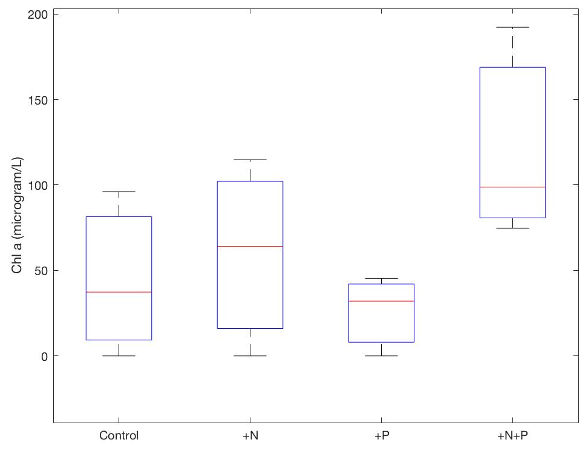
Water column test
Nutrient Limitation tests
  Nutrient:320 µmol/L of NH₄NO₃-N and 20 µmol/L K₂HPO₄-P ; 16:1 ratio
  Continuously mixed using orbital shaker and were manually agitated twice a day
  Room temperature (~25 ℃)
  Continuous light [Jump Start 2' - 24w/HO/6500K]
  Test ran for 5 days
  Samples were filtered with a 0.45 µm for Chlorophyll a extraction
After 2 hrs :
Measured (triplicate) final PO₄⁻³ – P for all columns
Sample collected in October 2016
Control +N +P +NP
column | initial (pH = 7.5) | AFTER 2 hrs (pH = 7.5) | INITIAL (ph=8.5) | AFTER (ph=8.5) | AFTER | percent decrease at ph= 8.5 | percent decrease at ph=9.5
 |  |  |  |  | (ph = 9.5)
control | 0.12 | 0.11 | 0.22 | 0.17 | 0.077 | 23% | 55%
sample + secondary effluent | 0.53 | 0.49 | 0.64 | 0.49 | 0.082 | 23% | 83%
sample + secondary effluent + CaCl2 | 0.48 | 0.51 | 0.67 | 0.55 | 0.089 | 18% | 84%
Initial chl a = 6 µg/L

Slide 5
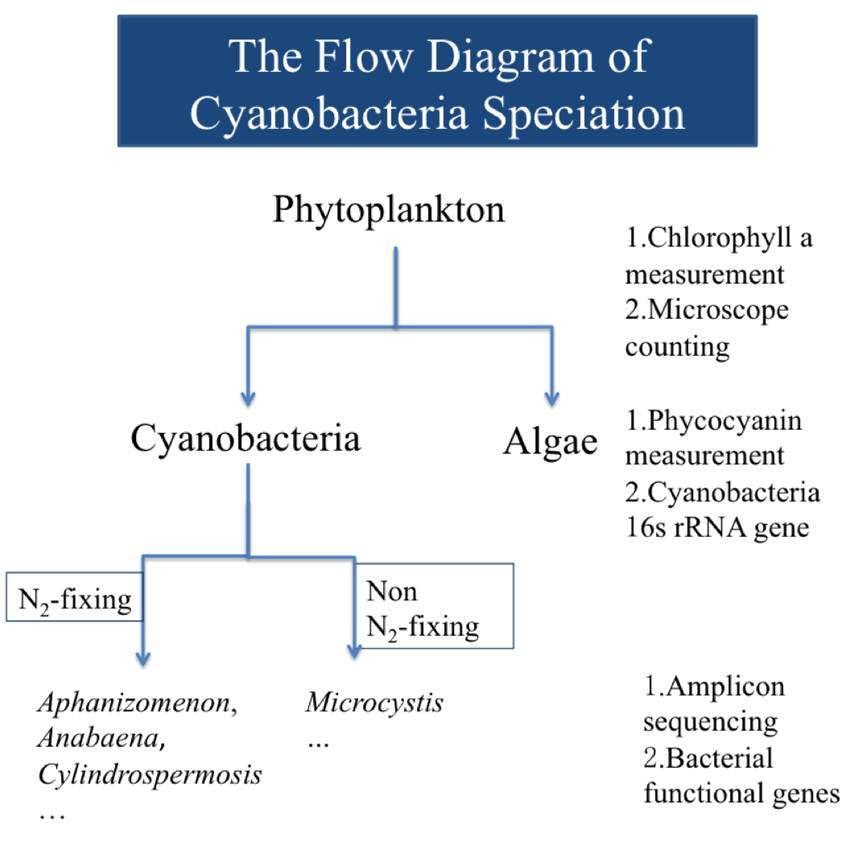
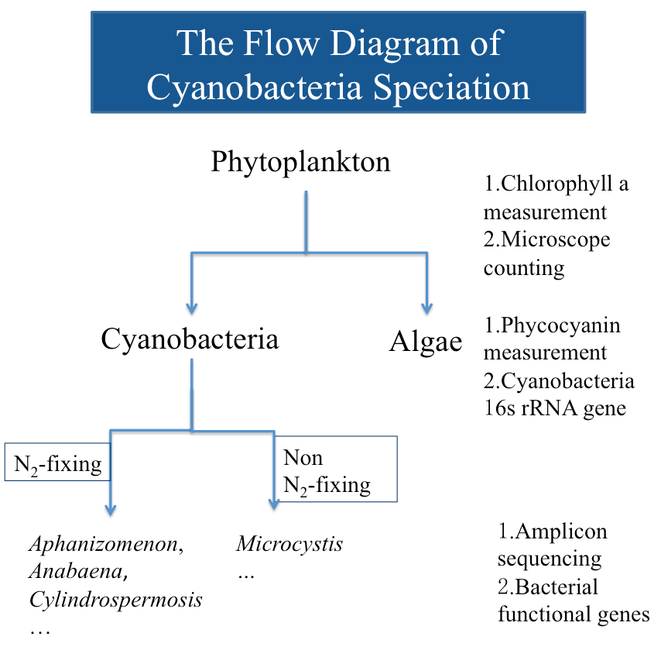

Slide 6
Cyanobacterial Speciation
Amplicon DNA Sequencing : Primer : universal bacterial 16s rRNA (515F-806R)
Notes:
REMOVE SHANNON diversity
3 mthids:
- Microscope base (rushforht is using)
Phycocyanin
Different genus can have same morphology, nearly accurate, genetic based sequencing can give you fine scale resulution, as you can recall temp was about constant
High pH, primary connection, bacteria breathing increase pH highly productive
Nutrient concentrations similar
Why did we have July? Tipping point, we want to evalualte the point why it occurs,
Correlate with Loose-bound P
Still analyzing data, to correlate, we are still correlating,
We are writjng a manuscript
Last slide, take from Hanyan, what to do
Manuscript , cyanobacteria density with pore water nutrient concentration, pore water nutrients (still analyziing data)
EPA modeling part,
We can convert the % relative abundance to number/L using qpcR

Slide 7
Shannon Diversity Index: Measure richness and evenness, in the range of 1.5-3.5, higher value indicates higher diversity
Site | June | July | August
Provo Bay | 1.25 | 0.96 | 1.21
Pelican Point | 0.98 | 0.73 | 0.27
Lincoln Beach | 0.98 | 1.21 | 0.53
Geneva Discharge | 0.93 | 1.19 | 1.34
Saratoga Springs | 0.87 | 1.32 | 0.83

Slide 8

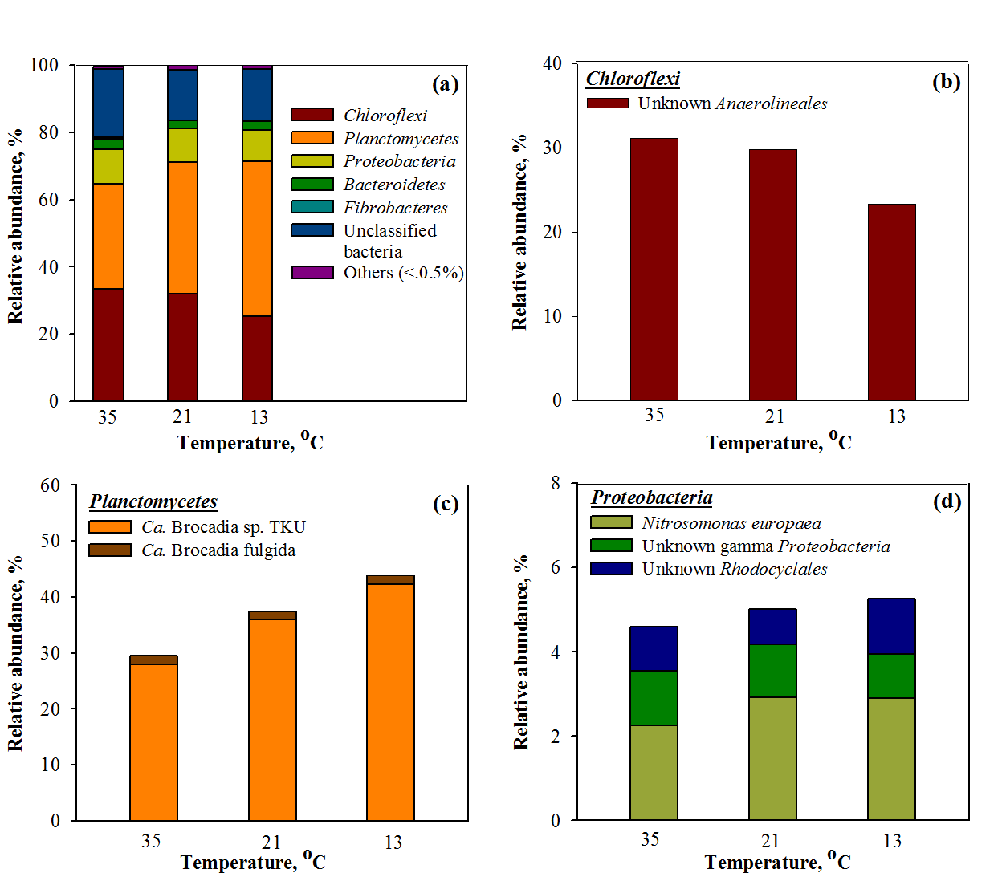
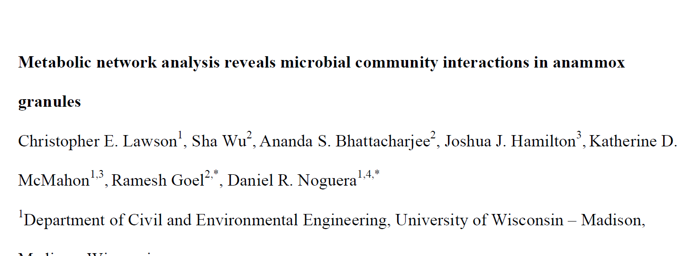
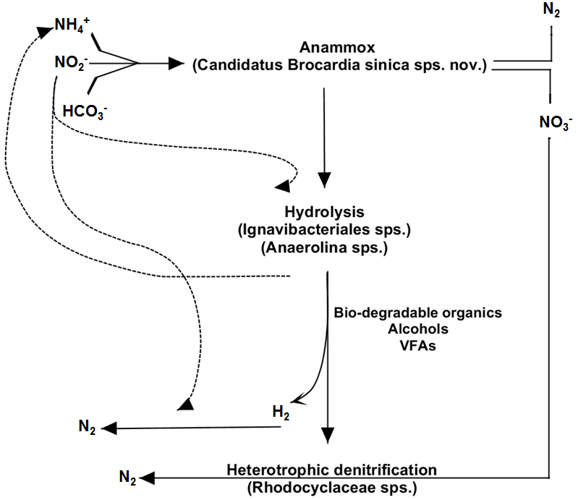
Microbial communities
Metabolic pathways to determine tipping point
Accepted in Nature Communications
Track all functional gene
 | AMO | HAO | NIR | NAR | HZS | HDH
35°C | 17.4 | 8.4 | 7.9 | 7.32 | 22.5 | 7.5
21°C Instable | 22.4 | 6.9 | 6.4 | 6.3 | 17.4 | 6.7
21°C Stable | 18.6 | 7.6 | 7.3 | 6.9 | 16.9 | 6.8
13°C | 27.7 | 5.7 | 6.1 | 4.2 | 10.6 | 5.7
Notes:
Anaerolineals was the only group under Chloroflexi. Andthe deep analysis under…suggested that the low temp did not select for any new cold tolerant species.

Slide 9
Differential Gene Expression
Expression of Transcripts
Ideal condition PN/A reactor
Down regulation in expression of transcripts, highlights instability PN/A reactor
Up regulation in expression of transcripts, highlights PN/A reactor attaining stability.
Minimum expression of transcripts, highlights PN/A reactor instability at low temperature.
21~23°C Instable
21~23°C Stable
33~35°C Stable
13~15°C Stable
Notes:
The Heat-map, represents a hierarchical clustering of transcripts that are most differentially expressed (most significant P-values and fold-changes).
The differential of expression of transcripts, clearly shows up-regulated and down-regulated transcripts with difference in temperature.

Slide 10
Summer 2017
Nutrient limitation tests for each site
Water column P tests for each site
Collect sediment, before, during, and after bloom
(sediment pore water)
Tipping point : metabolic pathway

Slide 11
Utah Lake Mineral Composition by % mass (top 1 - 5cm)
 | Carbonate Minerals |  | Clay Minerals |  |  | Silica Oxides | Feldspars |  | Iron-rich Silicate Minerals
Sample | Calcite | Dolomite | Smectite | Illite | Kaolinite | Quartz | Plagioclase | K-Feldspar | Amphibole
Lincoln Beach | 75 | 3 | tr | 12 |  | 10
Saratoga Springs | 71 | 3 | tr | 9 |  | 10
Pelican Point | 59 | 4 | tr | 4 | 2 | 20 | 6 | 4
Provo Bay | 10 | 4 | tr | tr | tr | 62 | 18 | 3 | 4
Geneva Discharge | 71 | 4 | tr | 10 |  |  | 2 | 2
tr (trace) indicate that mineral is present, but that its abundance calculated from the Rietveld refinement was less than one weight percent, and/or it was observed in the clay-sized fraction, but not in the bulk sample.

